Slide 1
Tablet Test Launch:Customer
Survey Results & Next Steps

Slide 2
Summary
Our team successfully test launched the Tablet rollout at 2 of the Sauce & Spoon locations. We achieved this rollout after working with our consultant Seydou to research and select a tablet system, and then worked with both our in-house team and out-of-house vendor terrific Tablets to design content for the tablets and have them integrated with our current POS software.
After completing 2 round of training, we have performed a test launch in both the locations where 50 customers engaged with the new tablet experience, and then completed a digital survey afterwards.

Slide 3
Overview
The survey was designed to collect data on customer satisfaction. We hoped to answer questions to be like:
Are the customers having a better dining experience with our new tablets?
Are the tablets saving time?
Do the tablets worked as expected?
Are the customer receiving the correct orders?
Through consulting experts, looking at the past projects, and conducting research we determined indicators including results such as:
The average ticket time is 8 minutes or less for appetizers and 12-15 minutes for entrees.
Average checkout time for guest is less than 1 minute.
Less than 5% of the customer who used the tablet reported technical issues each week.
98% of the customer got the accurate order.

Slide 4
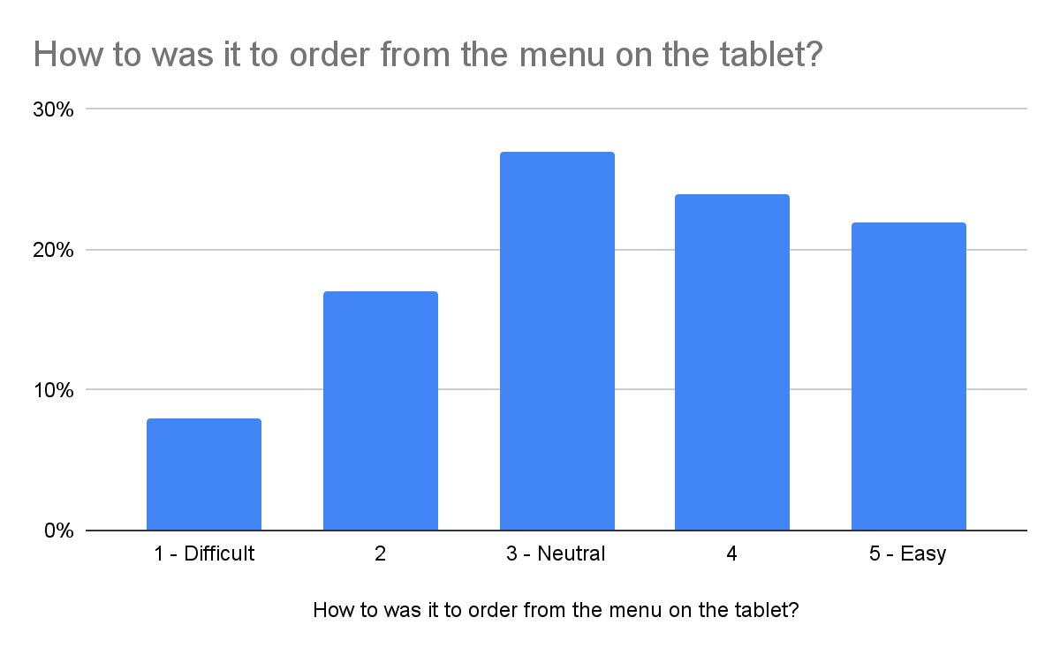
Findings

Slide 5
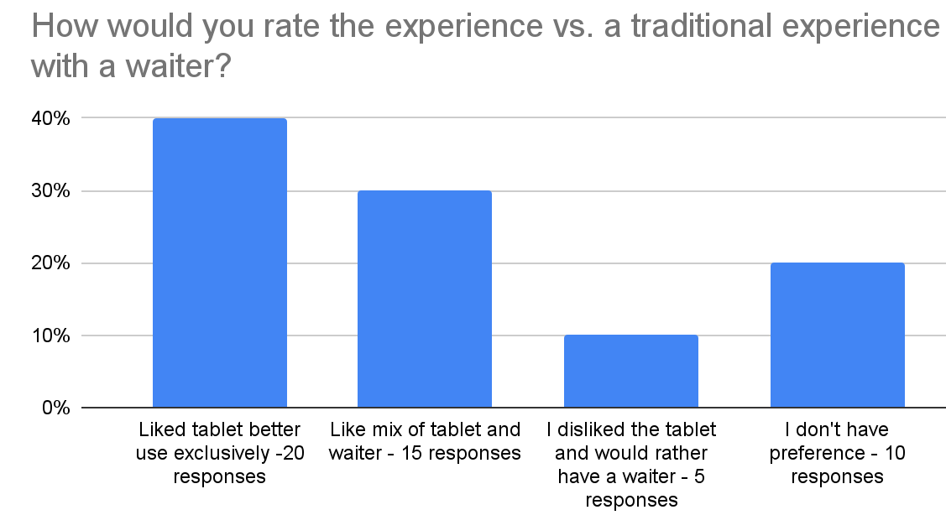
Findings

Slide 6
Next Steps
Recommendations:
1) Training on how to introduce software for kitchen staff:
The point of the tablets was to increase the accuracy of order, and having the wrong order come to their table negatively impacts their impression of the new tablets. I want to hold I want to hold another short training on how to introduce the tablet with the BOH staff.
Some comments were:
“Entree was overcooked”
“I asked for a side of fries and got mashed potatoes”
“Didn’t make the substitution I wanted”
28 % of customers responded that the kitchen did not prepare their order correctly.

Slide 7
Next Steps
14% of the customer responded having a neutral experience with tablets 14% having a negative experience
1) Training on how to introduce software for servers:
Someone’s first exposure to a new technology and a new way of experiencing dining in your business is key to their impression of the tablets. I want to hold another short training on how to introduce the tablet with the servers, and send out an email to all wait staff where they can ask questions on the tablets anonymously that will be answered by myself,Deanna, and Seydou.
2) Adjust Tablet layouts:
Deanna and I need to reassess the layout of the tablet pages, and regorganize and adjust where needed. For example, the menu page first, instead of an introduction message where steps are needed to view the selections. Once a plan is ready, we will schedule a time with Terrific. Tablets to update the tablets layouts.

